Slide 1
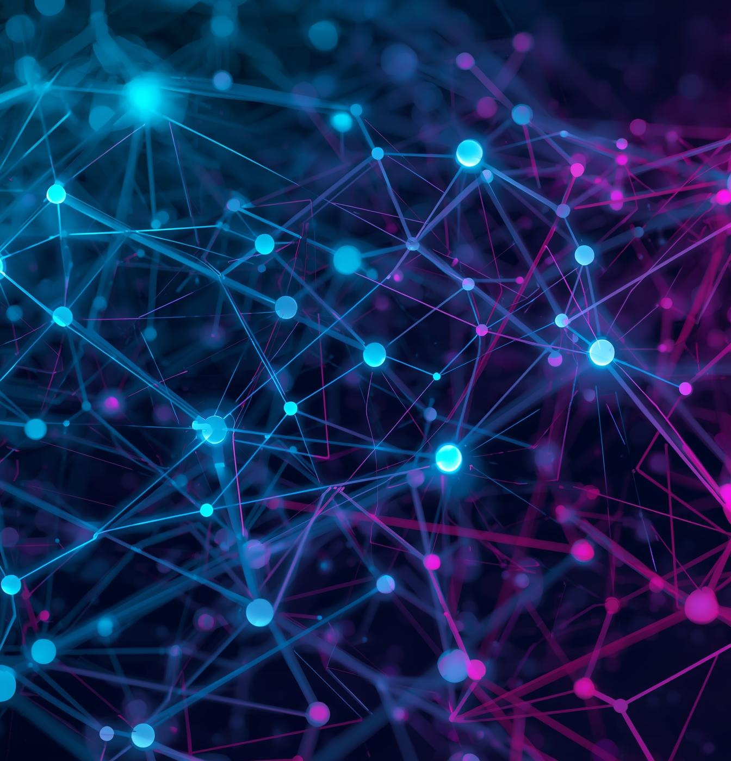

December 25, 2025
Building a RAG System
Complete RAG System

Slide 2

Why RAG Is Needed
RAG addresses critical issues like hallucination, limited data access, and outdated training, ensuring reliable AI responses.

Slide 3

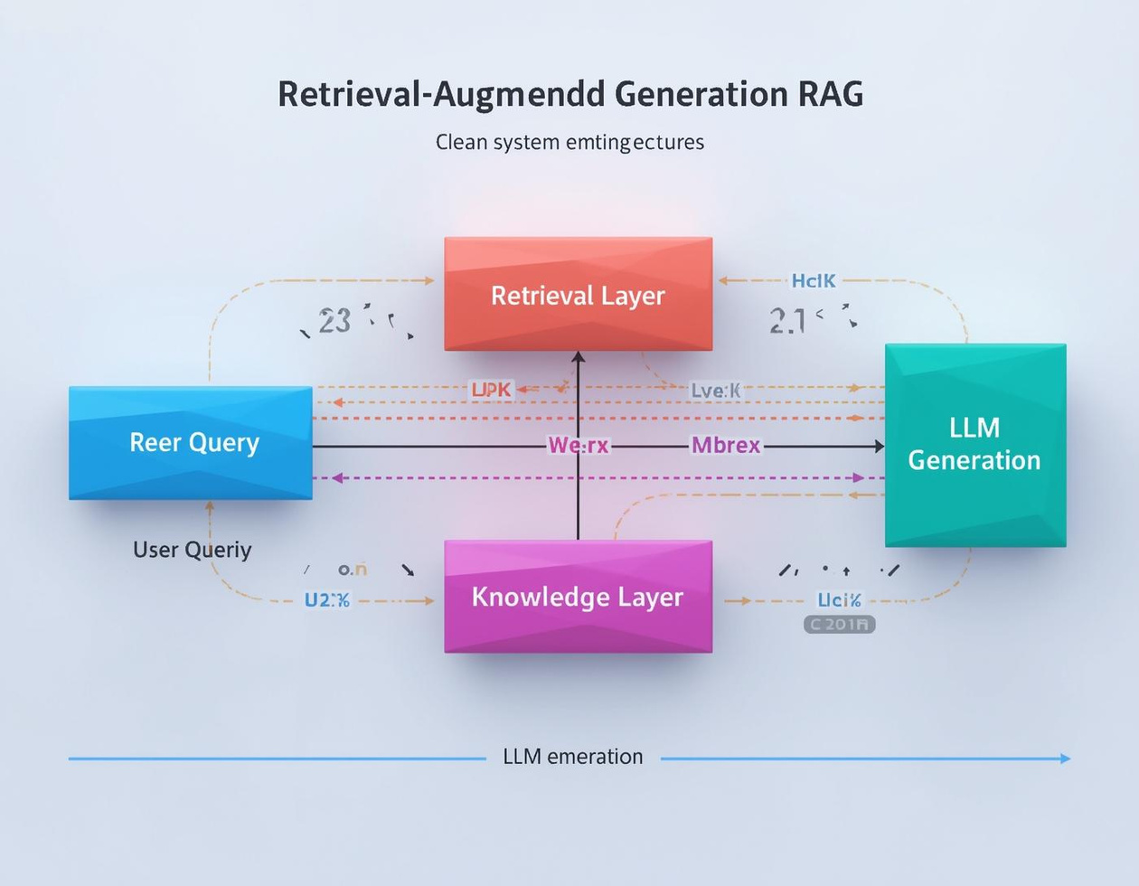
Overview of RAG System Architecture
Understanding the flow of information
This architecture supports seamless data retrieval and generation.

Slide 4
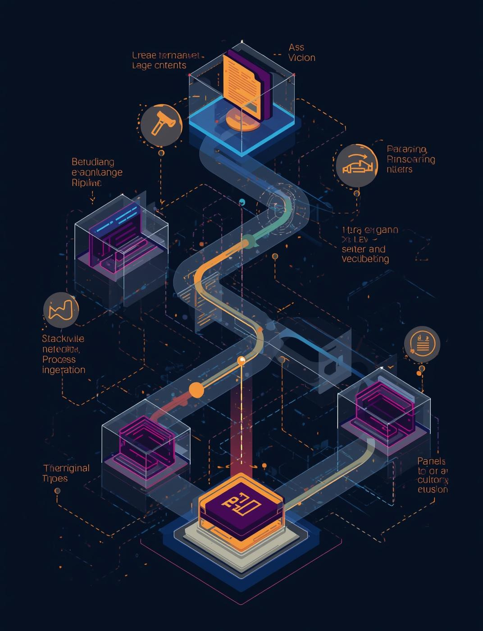
Data Ingestion
The process involves gathering various document types, ensuring data quality through parsing, cleaning, and metadata extraction.

Slide 5

Chunking Strategy
Effective document chunking ensures context preservation while managing token limits for optimal LLM performance and accuracy.

Slide 6

Embedding & Vector Database
Converting text to vectors enables efficient similarity search and effective filtering using relevant metadata for accurate retrieval.

Slide 7

Understanding the Retriever Design Process
Selecting Relevant Context Efficiently
The retriever design ensures high-quality results.

Slide 8
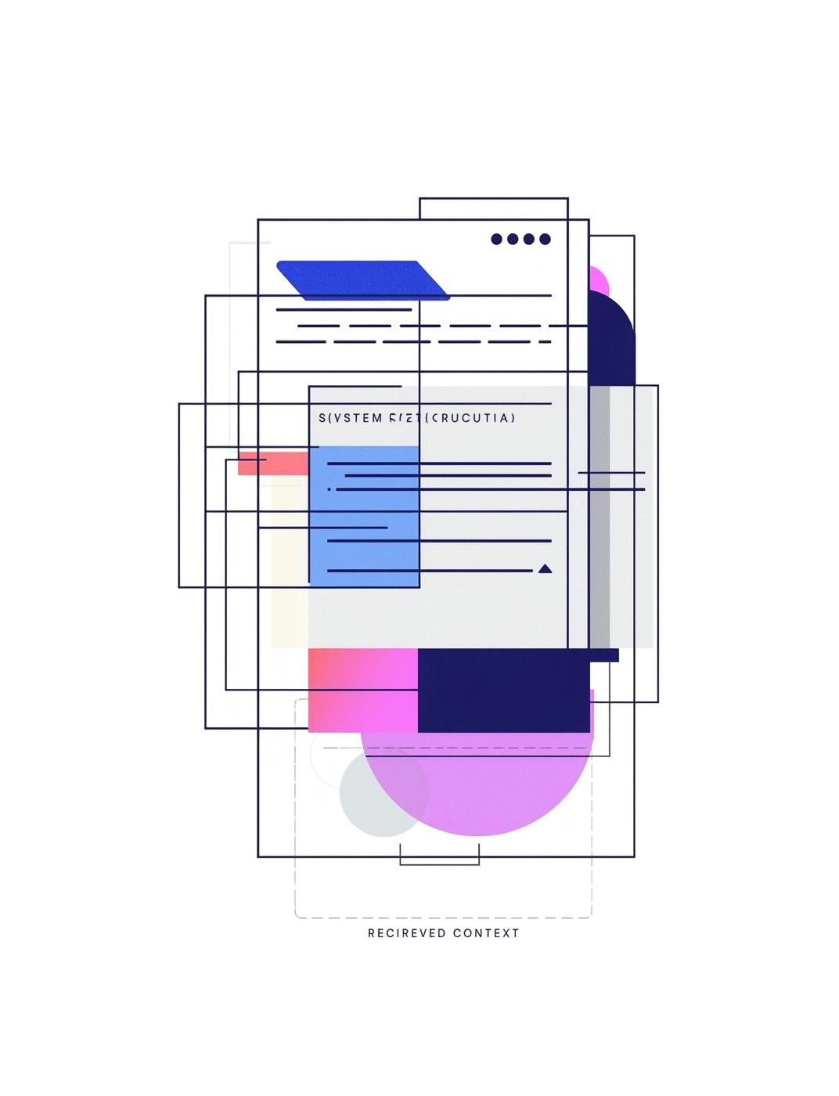
Prompt Template
A structured prompt combines system instructions, retrieved context, and user questions to enhance LLM response accuracy.

Slide 9
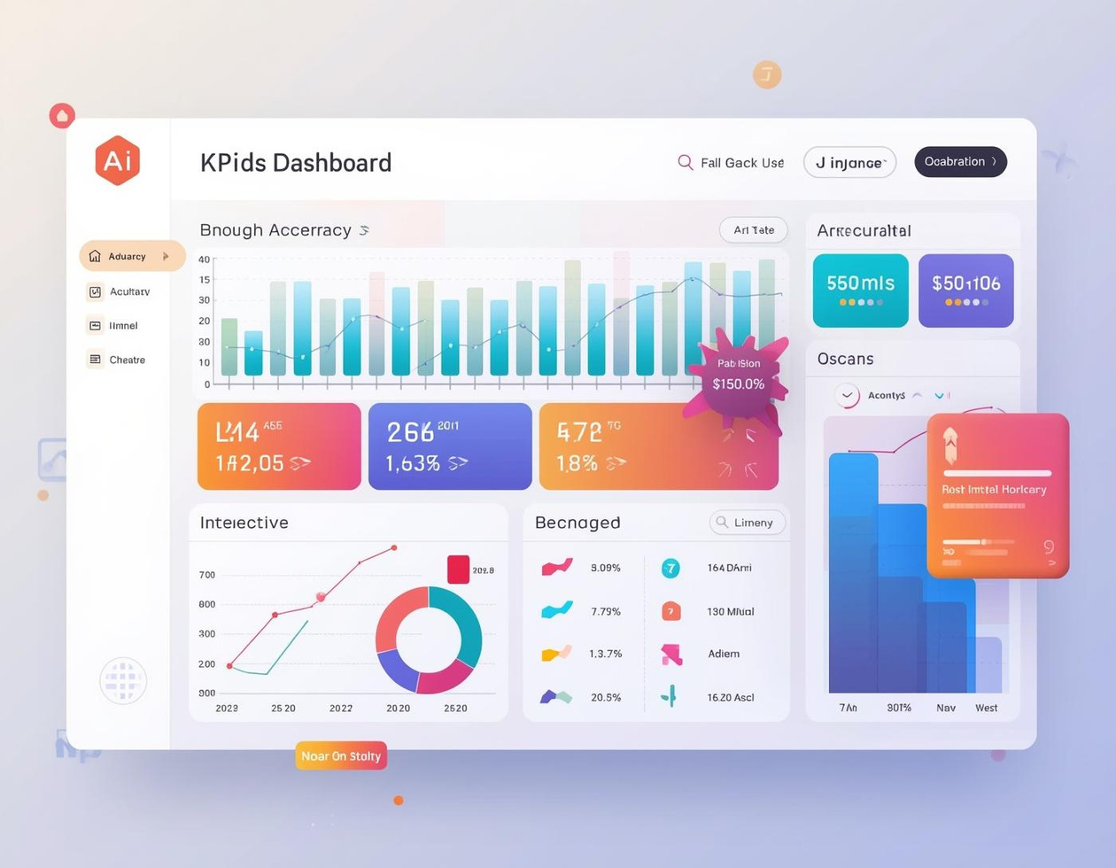
Generation and Evaluation of RAG Outputs
Assessing Performance and Optimization Strategies
Evaluating accuracy and cost-effectiveness is crucial.

Slide 10
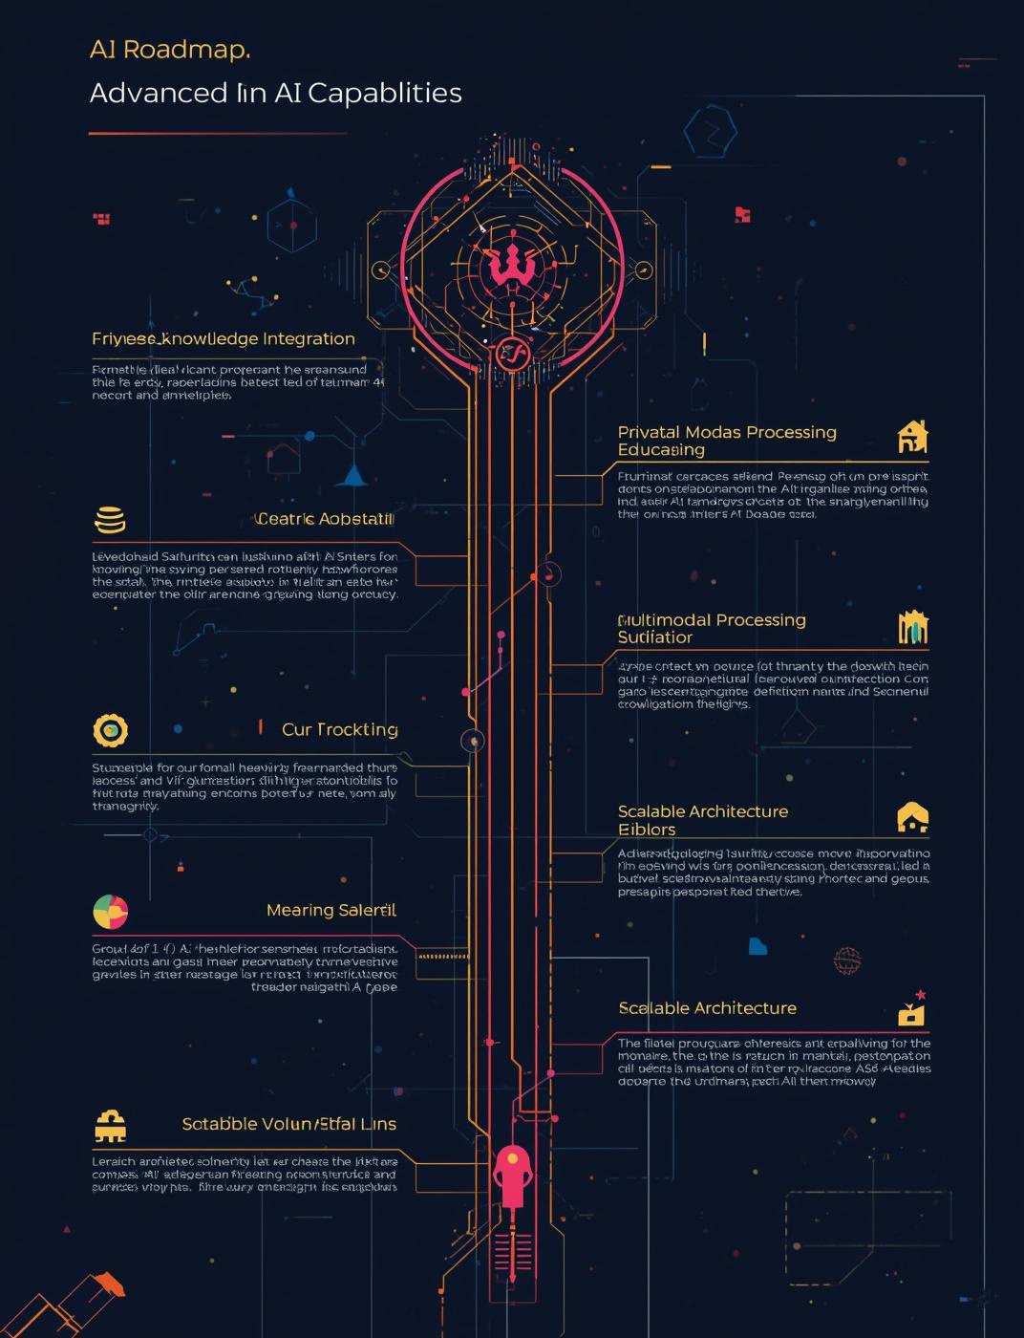
Future Roadmap
The RAG system is designed for private knowledge AI and multi-modal capabilities, ensuring scalability and adaptability for future needs.

